Slide 1
Prospex: Broadening Tech Career Horizons

Slide 2
1.
Problem
Lack of Exposure to Different Career Paths

Slide 3
Lack of Exposure to Different Career Paths
Narrow focus on a few career opportunities
Not enough visibility and resources for other roles
Difficult to find a community to talk to about non-mainstream roles

Slide 4
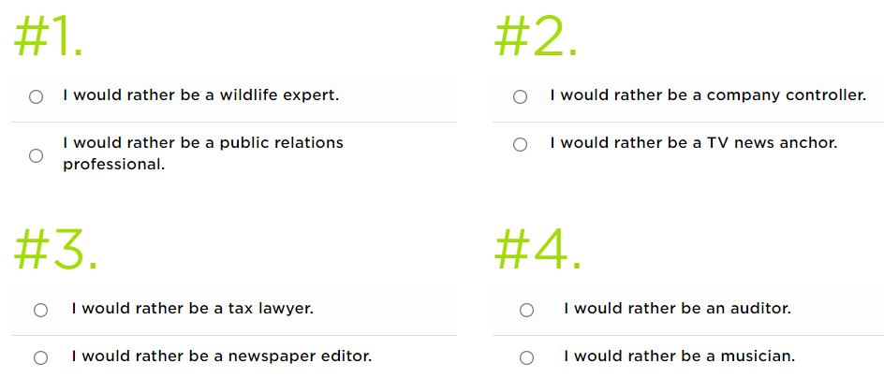
Career Quizzes are NOT the Solution
Too broad to be useful
Confirms existing biases
Princeton Review Career Quiz

Slide 5
Why Personality Quizzes are NOT the Solution
Fundamentally not related to careers
Provides little support for career goals
More detailed/helpful ones behind a paywall or for corporate clients

Slide 6
Proposed Solution
Gamified environment with career-oriented personality questions
provide resources and a community

Slide 7
Initial Career Fields
Product Management
UI/UX
Quantitative Finance
Tech Startups
Academia and Research

Slide 8
Data Collection
Surveyed professionals in the fields
Received over 80 responses
Responders came from:
UChicago communities
Young professionals’ networks
Interviewed people directly in product, UI/UX, and academia/research

Slide 9

2.
Implementation
Gamified interactive environment

Slide 10
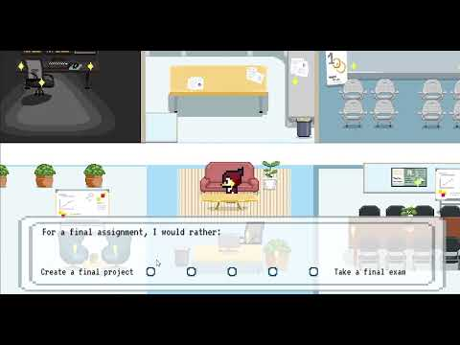
Demonstration

Slide 11

Why a Game?
Designed platform for students at the University who want to pursue a career in tech
Games as a medium allow for interactive experience
Memorable, Shareable, Evocative

Slide 12

Platform Implementation
Students navigate the game environment with Phil the Phoenix
Answer questions curated from data collection process
K-Nearest-Neighbors Algorithm provides career path suggestions and relevant resources

Slide 13
3.
Next Steps
Plans for moving forward

Slide 14
Roadmap
Current version of the platform and algorithm
Add more career paths
Create a login system for students to create profiles
1
3
5
2
4
6
Collect more data
Fine-tune algorithm with test participants
Build a community platform for users to interact on

Slide 15
4.
Team
How the solution became possible

Slide 16



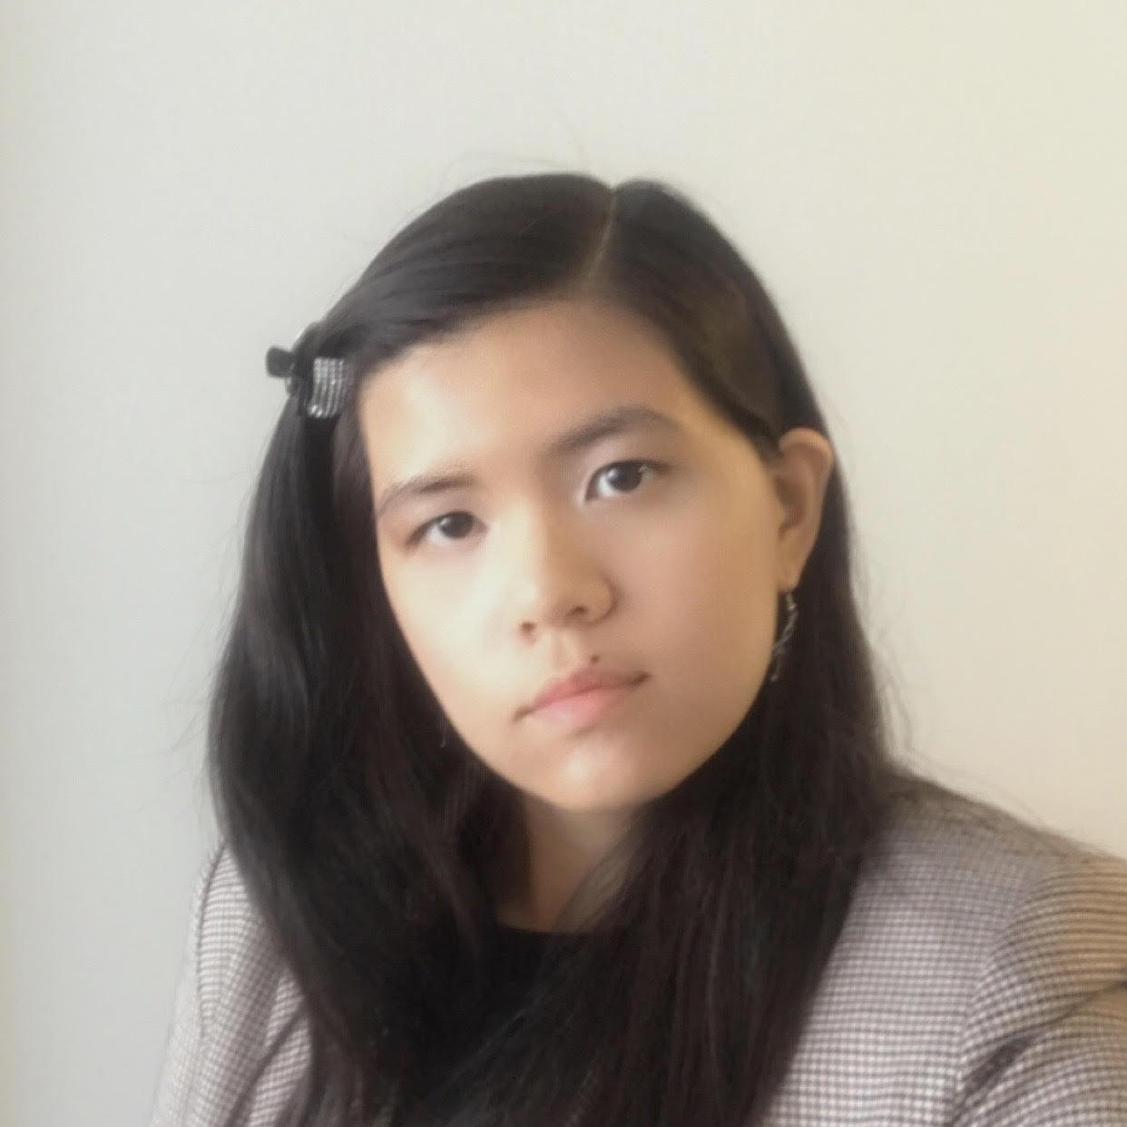
Team Members
Anke Hao Team Lead
Computer Science + Psychology
2023
Emily Cheng Game design + Pixel Art
Media Arts & Design + English
2023
Max Chou Developer
Computer Science + Statistics
2024
Catherine Charles Content Research
Computer Science + Economics
2023

Slide 17
5.
Questions?

Slide 18
6.
Appendix

Slide 19
Survey Snapshot: Product Management
People in Product tend to:
be best at switching different roles within a group
present using visual representations
prefer final projects over final exams

Slide 20
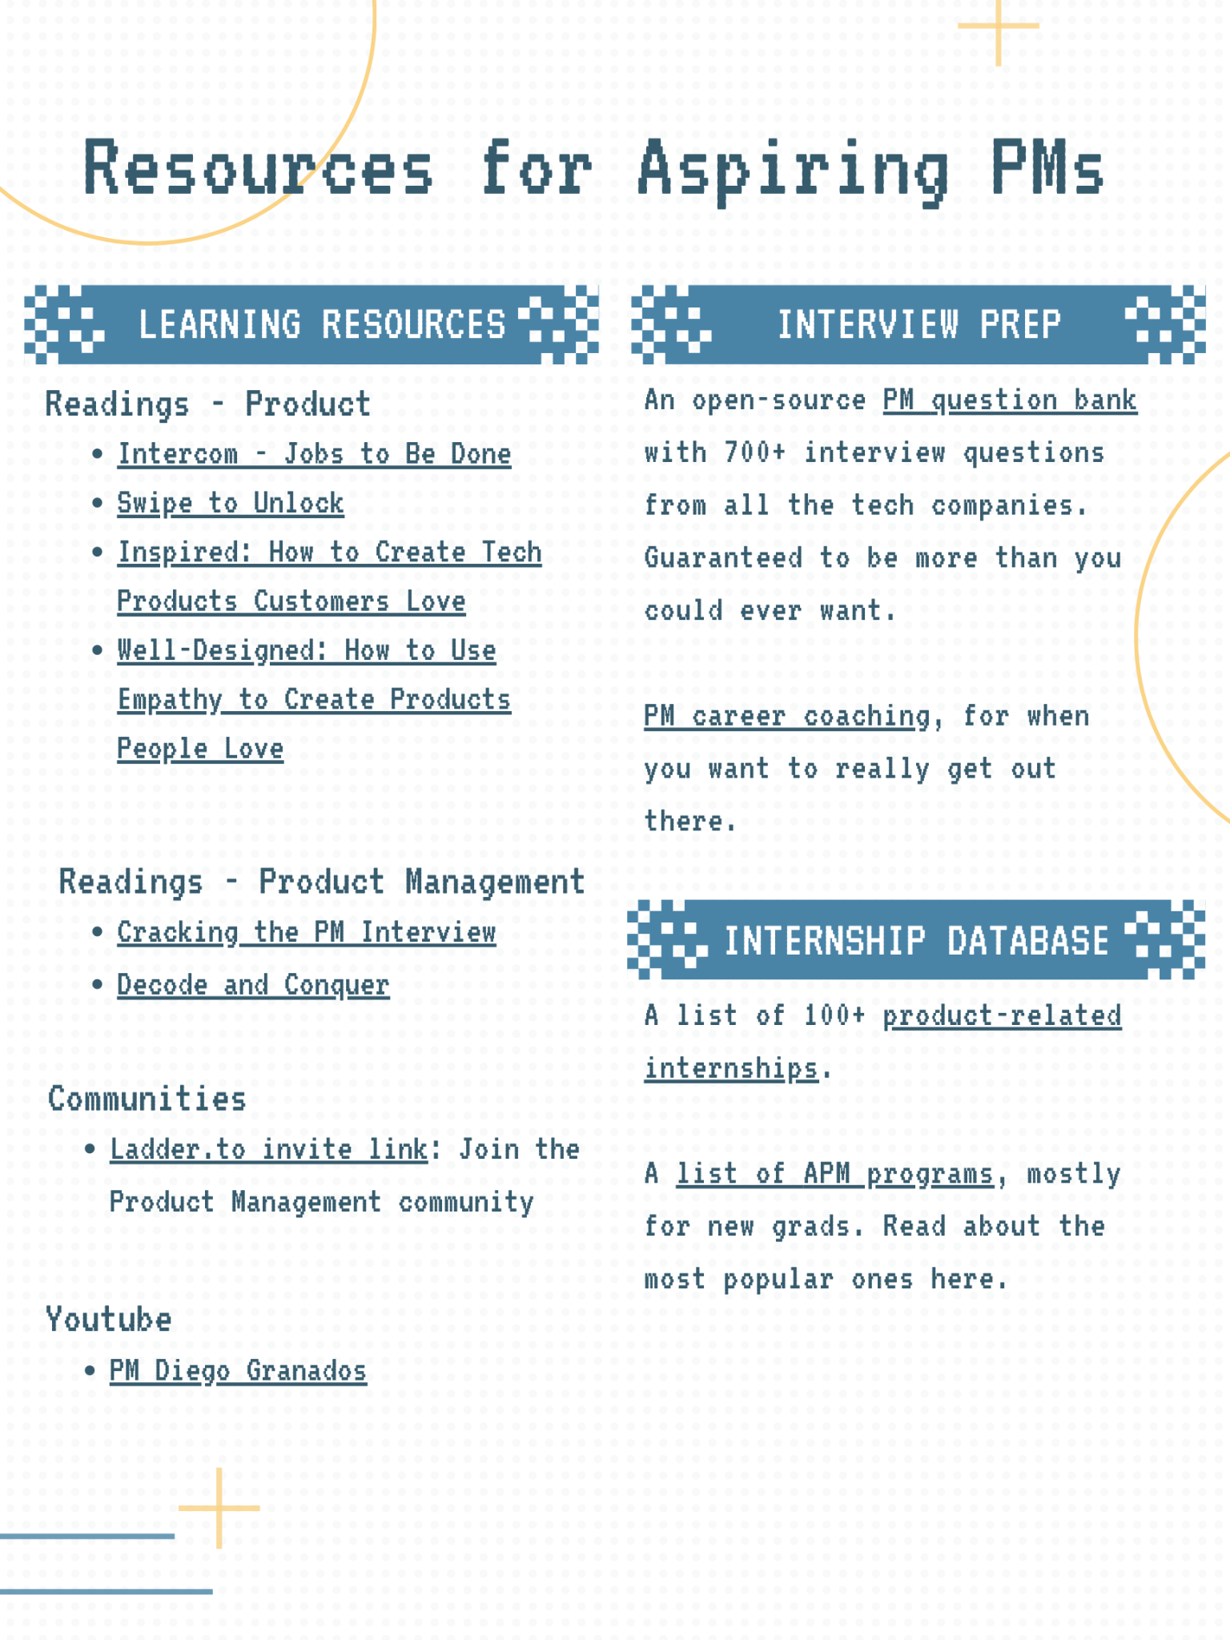
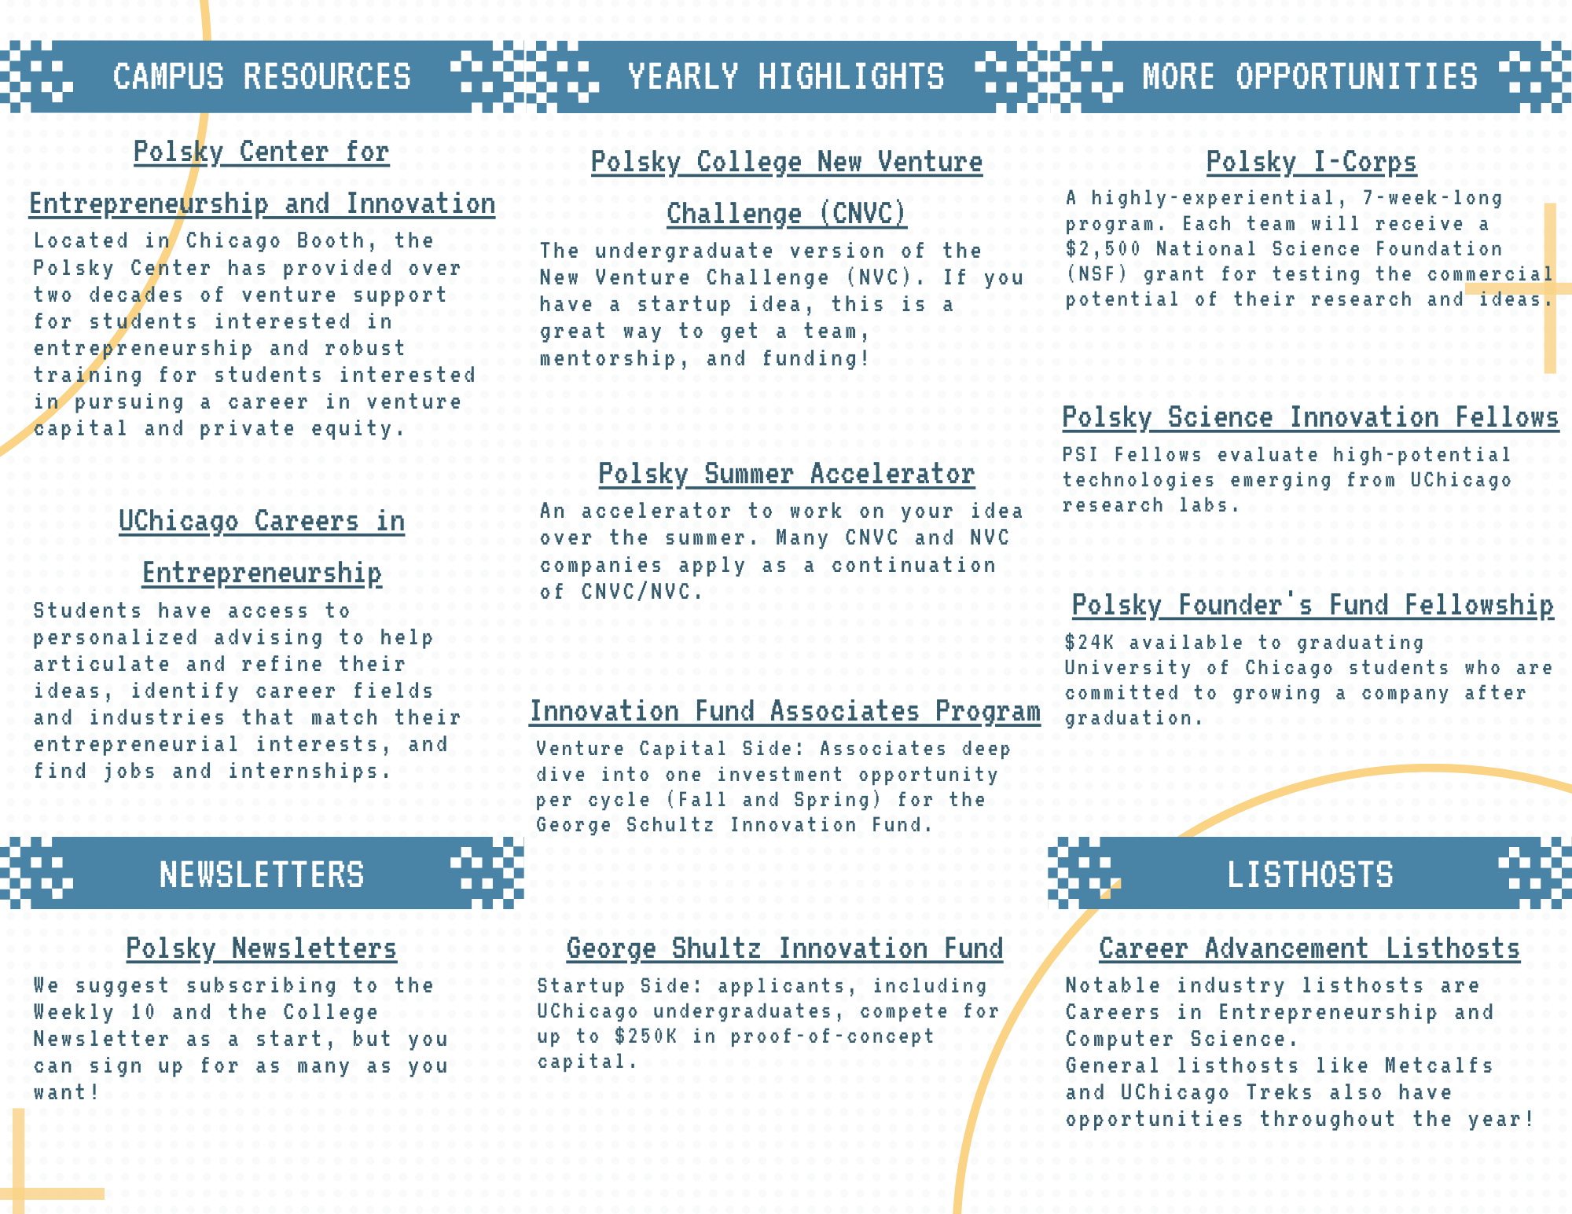
Resource Snapshots

Slide 21
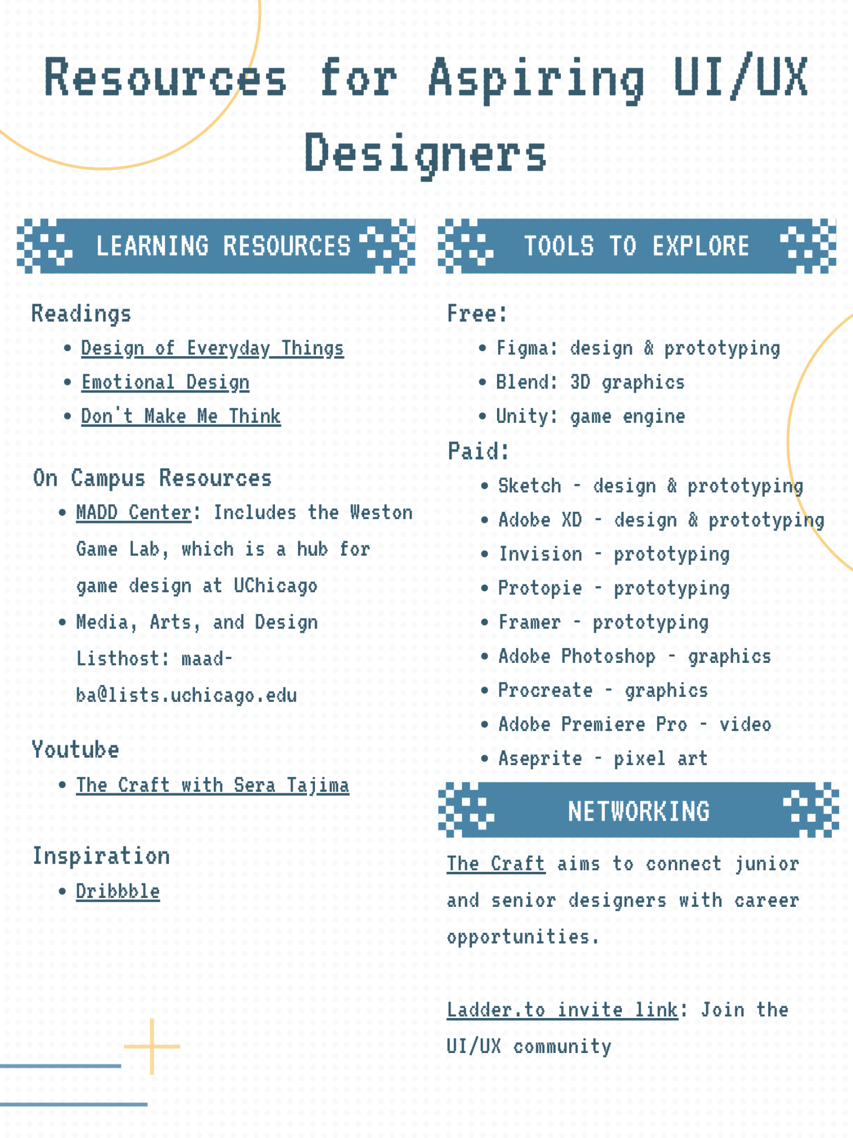
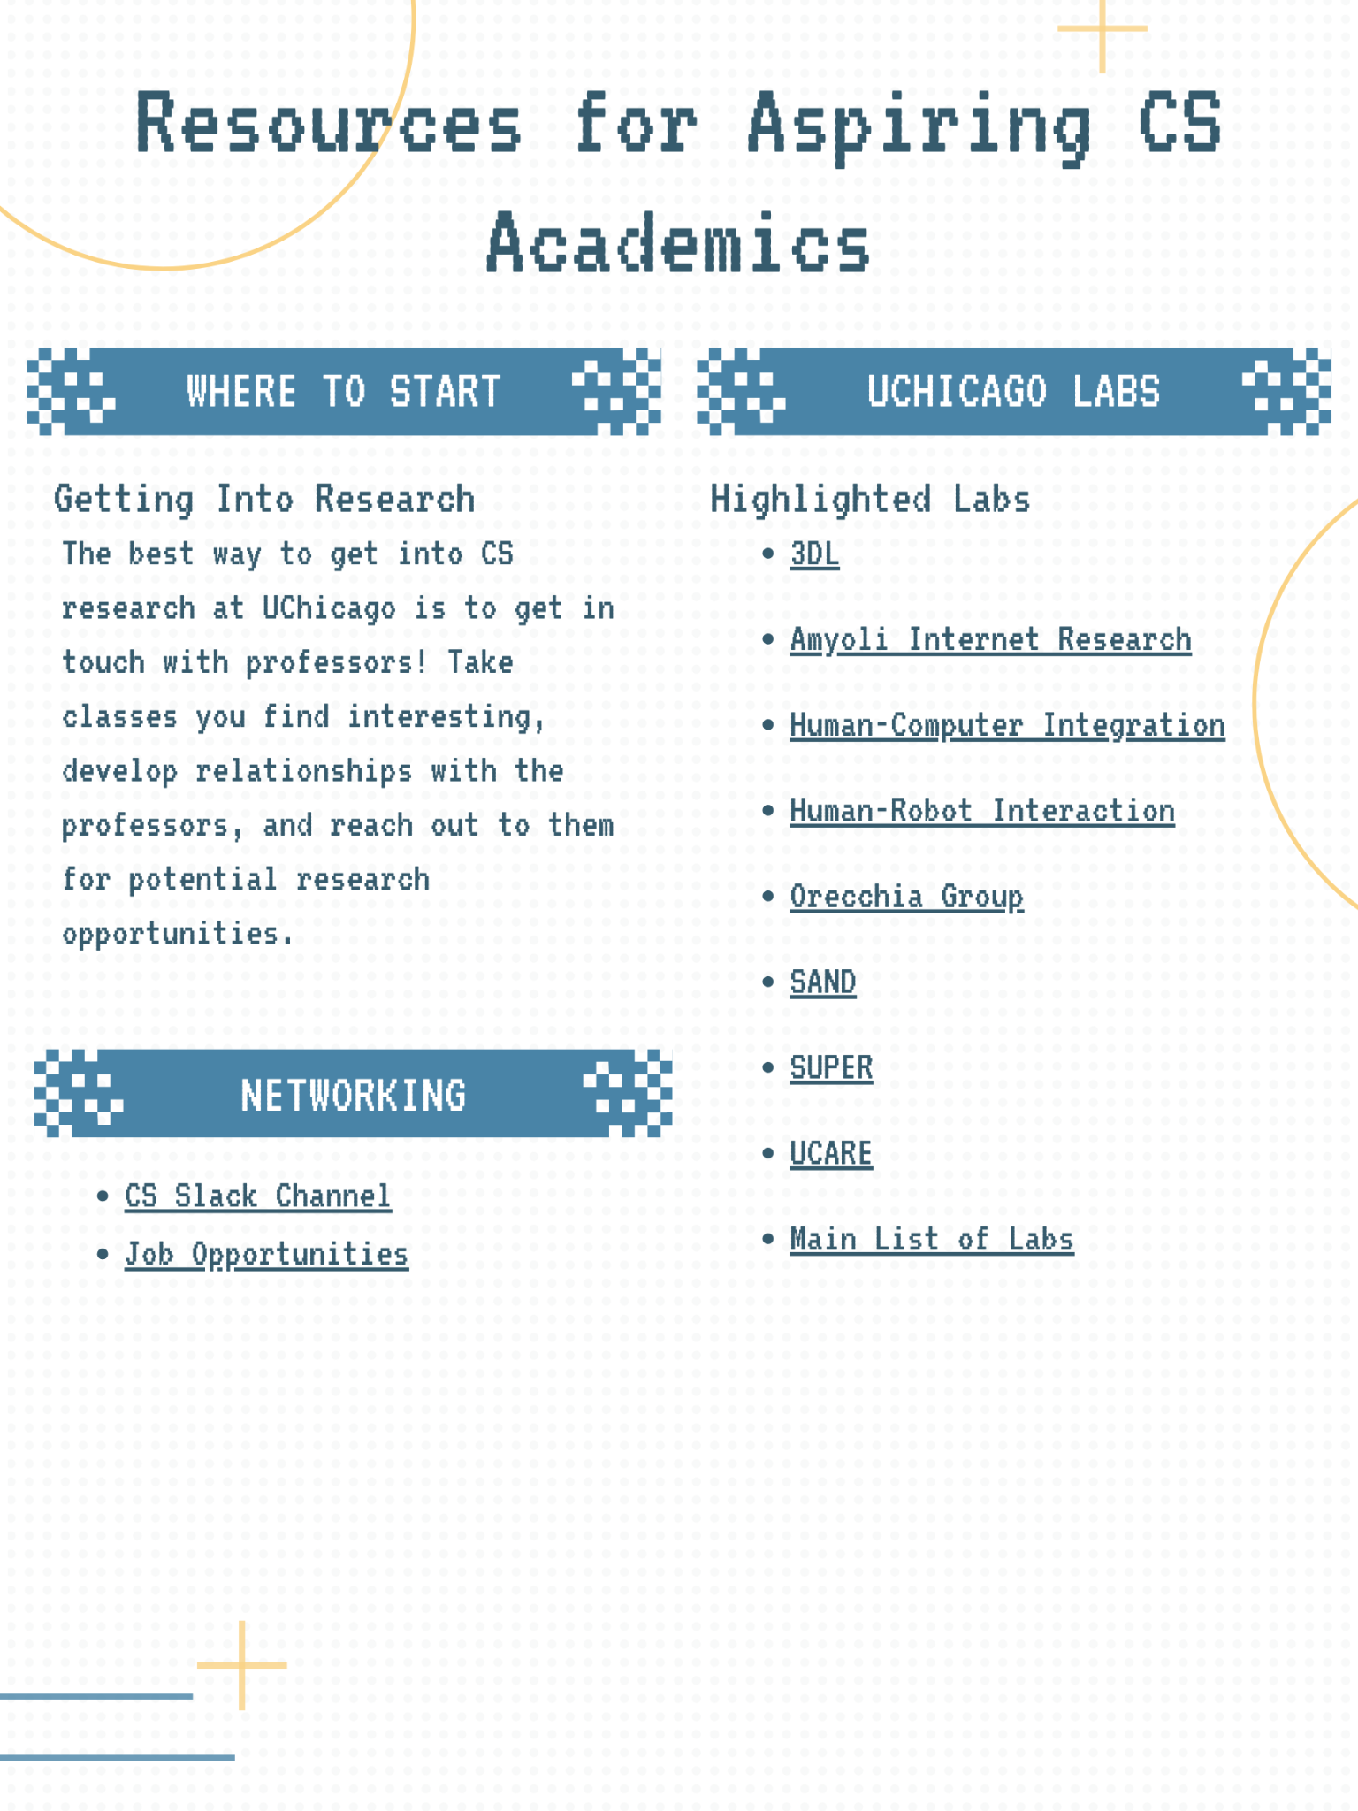
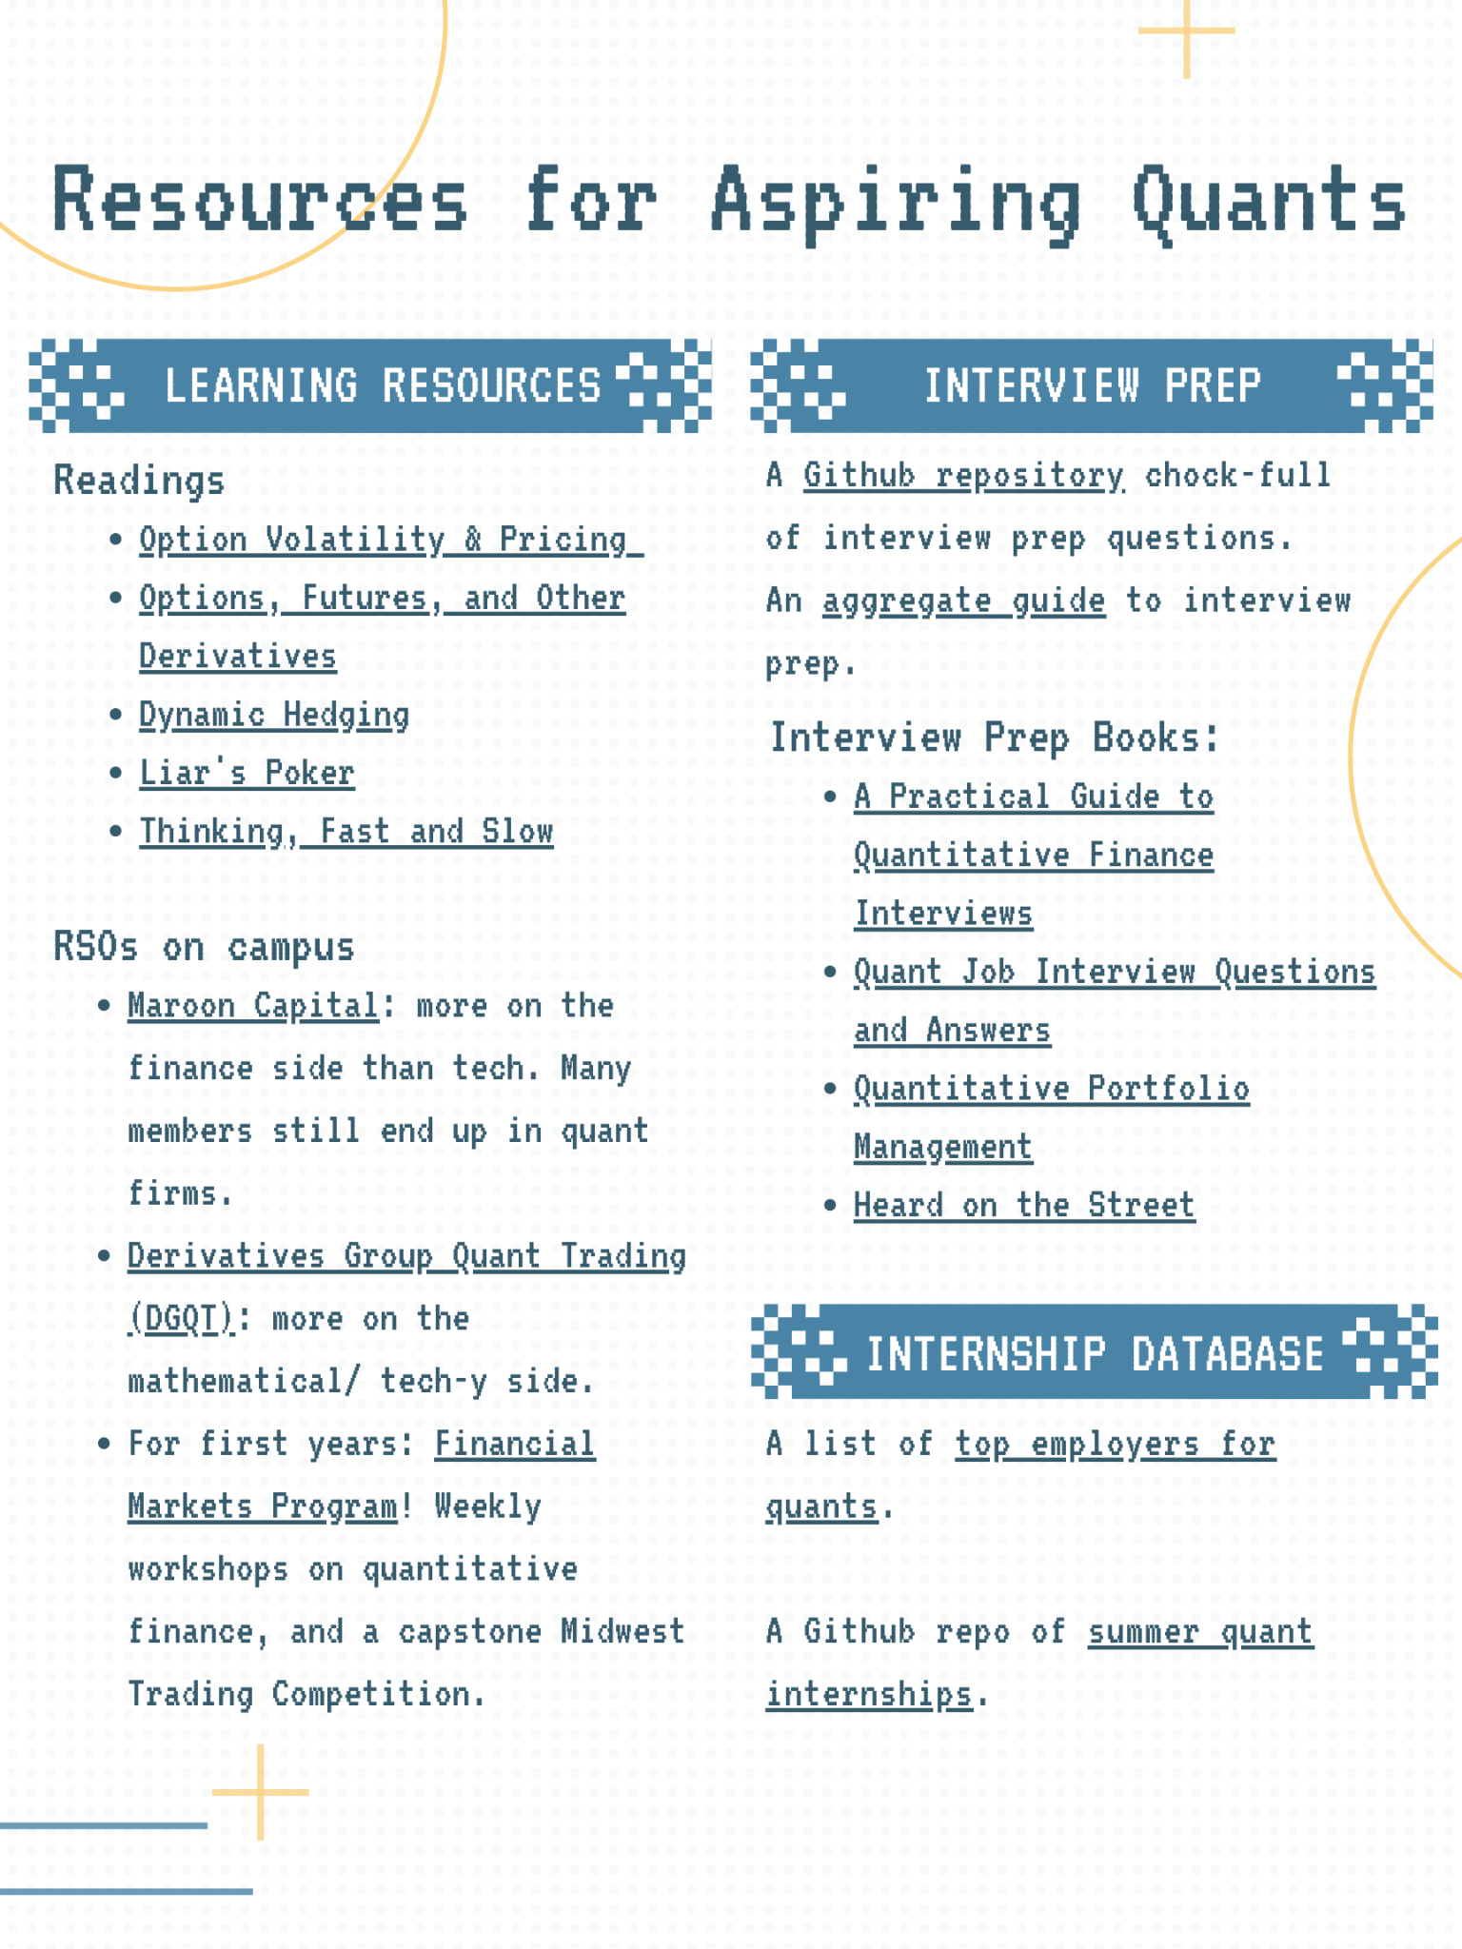
Resource Snapshots

